Slide 1

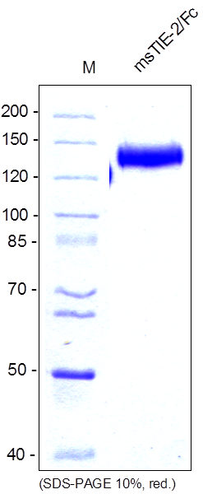
Reliatech GmbH
Mouse soluble TIE2-Fc Chimera (CHO cells)
(Cat# SFC-033 / SFC-034))
Figure 1: SDS-PAGE analysis of recombinant mouse sTIE-2/Fc Chimera produced in CHO cells. Sample was loaded in 10% SDS-polyacrylamide gel under reducing conditions and stained with Coomassie blue.
http://www.reliatech.de / orders@reliatech.de

